Slide 1
Chapter 2: Unit Testing
DINH THI MY CANH

Slide 2
Contents
Concept of unit testing
Static unit testing
Defect prevention
Dynamic unit testing
Mutation testing
Debugging
Unit testing in extreme programming (XP)
Tools for Unit Testing

Slide 3
1. Concept of unit testing
Unit testing refers to testing program units in isolation
  such as functions, procedures, or methods, class
Unit testing is performed by the programmer
A programmer needs to test a unit as follows:
  Execute every line of code.
  Execute every predicate in the unit to evaluate them to true and false separately.
  Observe that the unit performs its intended function and ensure that it contains no known errors.

Slide 4
1. Concept of unit testing
Unit testing is conducted in two complementary phases:
  Static unit testing
    Code is examined over all possible behaviors that might arise during run time
    Code of each unit is validated against requirements of the unit by reviewing the code
  Dynamic unit testing
    A program unit is actually executed and its outcomes are observed
    One observe some representative program behavior, and reach conclusion about the quality of the system

Slide 5
1. Concept of unit testing
Static unit testing is not an alternative to dynamic unit testing
Static and Dynamic analysis are complementary in nature
In practice, partial dynamic unit testing is performed concurrently with static unit testing
It is recommended that static unit testing be performed prior to the dynamic unit testing

Slide 6
2. Static unit testing
In static unit testing code is reviewed by applying techniques:
  Inspection: It is a step by step peer group review of a work product, with each step checked against pre-determined criteria
  Walkthrough: It is review where the author leads the team through a manual or simulated executed of the product using pre-defined scenarios

Slide 7
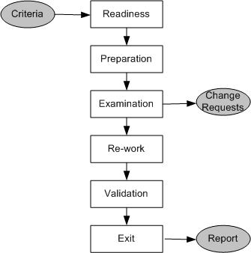
2. Static unit testing (code review)
Figure 3.1: Steps in the code review process

Slide 8
2. Static unit testing (code review)
Step 1: Readiness
Criteria
    Completeness
    Minimal functionality
    Readability
    Complexity
    Requirements and design documents
  Roles
    Moderator
    Author
    Presenter
    Record keeper
    Reviewers
    Observer

Slide 9
2. Static unit testing (code review)
Step 2: Preparation
  List of questions
  Potential Change Request (CR)
  Suggested improvement opportunities
Step 3: Examination
  The author makes a presentation
  The presenter reads the code
  The record keeper documents the CR
  Moderator ensures the review is on track

Slide 10
2. Static unit testing (code review)
Step 4: Re-work
  Make the list of all the CRs
  Make a list of improvements
  Record the minutes meeting
  Author works on the CRs to fix the issue
Step 5: Validation
  CRs are independently validated
Step 6: Exit
  A summary report of the meeting minutes is distributes

Slide 11
2. Static unit testing (code review)
A Change Request (CR) includes the following details:
  Give a brief description of the issue
  Assign a priority level (major or minor) to a CR
  Assign a person to follow it up
  Set a deadline for addressing a CR

Slide 12
2. Static unit testing (code review)
The following metrics can be collected from a code review:
  The number of lines of code (LOC) reviewed per hour
  The number of CRs generated per thousand lines of code (KLOC)
  The number of CRs generated per hour
  The total number of hours spend on code review process

Slide 13
2. Static unit testing (code review)
The code review methodology can be applicable to review other documents
Five different types of system documents are generated by engineering department
  Requirement
  Functional Specification
  High-level Design
  Low-level Design
  code
In addition installation, user, and trouble shooting guides are developed by technical documentation group

Slide 14
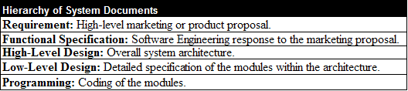
2. Static unit testing (code review)
Table 3.1: System documents

Slide 15
3. Defect prevention
Build instrumentation code into the code
Use standard control to detect possible occurrences of error conditions
Ensure that code exists for all return values
Ensure that counter data fields and buffer overflow/underflow are appropriately handled
Provide error messages and help texts from a common source

Slide 16
3. Defect prevention
Validate input data
Use assertions to detect impossible conditions
Leave assertions in the code.
Fully document the assertions that appears to be unclear
After every major computation reverse-compute the input(s) from the results in the code itself
Include a loop counter within each loop

Slide 17
4. Dynamic unit testing
The environment of a unit is emulated and tested in isolation
The caller unit is known as test driver
  A test driver is a program that invokes the unit under test (UUT)
  It provides input data to unit under test and report the test result
The emulation of the units called by the UUT are called stubs
  It is a dummy program
The test driver and the stubs are together called scaffolding
The low-level design document provides guidance for selection of input test data

Slide 18
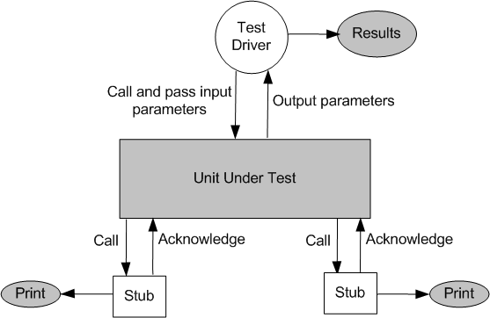
4. Dynamic unit testing
Figure 3.2: Dynamic unit test environment

Slide 19
4. Dynamic unit testing
Selection of test data is broadly based on the following techniques:
  Control flow testing
    Draw a control flow graph (CFG) from a program unit
    Select a few control flow testing criteria
    Identify a path in the CFG to satisfy the selection criteria
    Derive the path predicate expression from the selection paths
    By solving the path predicate expression for a path, one can generate the data
  Data flow testing
    Draw a data flow graph (DFG) from a program unit and then follow the procedure described in control flow testing.

Slide 20
4. Dynamic unit testing
Selection of test data is broadly based on the following techniques:
  Domain testing
    Domain errors are defined and then test data are selected to catch those faults
  Functional program testing
    Input/output domains are defined to compute the input values that will cause the unit to produce expected output values

Slide 21
5. Mutation testing
Modify a program by introducing a single small change to the code
A modified program is called mutant
A mutant is said to be killed when the execution of test case cause it to fail. The mutant is considered to be dead
A mutant is an equivalent tot the given program if it always produce the same output as the original program
A mutant is called killable or stubborn, if the existing set of test cases is insufficient to kill it

Slide 22
5. Mutation testing
A mutation score for a set of test cases is the percentage of non-equivalent mutants killed by the test suite
The test suite is said to be mutation-adequate if its mutation score is 100%

Slide 23
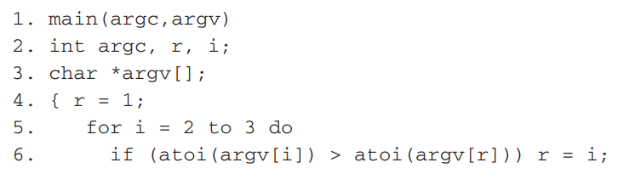

5. Mutation testing
Consider the following program P
Notes:
Tìm vị trí đạt giá trị lớn nhất

Slide 24
5. Mutation testing
Test Case 1:
input: 1 2 3
output: Value of the rank is 3
Test Case 2:
input: 1 2 1
output: Values of the rank is 2
Test Case 3:
input: 3 1 2
output: Value of the rank is 1
Notes:
Input là các phần tử mảng 1 chiều

Slide 25
5. Mutation testing
Mutant 1: Change line 5 to for i = 1 to 3 do
Mutant 2: Change line 6 to if (i > atoi(argv[r])) r = i;
Mutant 3: Change line 6 to if (atoi(argv[i]) >= atoi(argv[r])) r = i;
Mutant 4: Change line 6 to if (atoi(argv[r]) > atoi(argv[r])) r = i;
Execute modified programs against the test suite, you will get the results:
Mutants 1 & 3: Programs will pass the test suite, i.e., mutants 1 & 3 are not killable
Mutant 2: Program will fail test cases 2
Mutant 1: Program will fail test case 1 and test cases 2
Mutation score is 50%, assuming mutants 1 & 3 non-equivalent
Notes:
50% vì chỉ có đột biến 1 và 2 bị fail

Slide 26
5. Mutation testing
The score is found to be low because we assumed mutants 1 & 3 are nonequivalent
We need to show that mutants 1 and 3 are equivalent mutants or those are killable
To show that those are killable, we need to add new test cases to kill these two mutants
First, let us analyze mutant 1 in order to derive a “killer” test. The difference between P and mutant 1 is the starting point
Mutant 1 starts with i = 1, whereas P starts with i = 2. There is no impact on the result r. Therefore, we conclude that mutant 1 is an equivalent mutant

Slide 27
5. Mutation testing
Second, if we add a fourth test case as follows:
Test Case 4:
input: 2 2 1
Program P will produce the output “Value of the rank is 1” and mutant 3 will produce the output “Value of the rank is 2”
Thus, this test data kills mutant 3, which give us a mutation score 100%

Slide 28
5. Mutation testing
Mutation testing makes two major assumptions:
Competent Programmer hypothesis
  Programmers are generally competent and they do not create random programs
Coupling effects
  Complex faults are coupled to simple faults in such a way that a test suite detecting simple faults in a program will detect most of the complex faults

Slide 29
6. Debugging
The process of determining the cause of a failure is known as debugging
It is a time consuming and error-prone process
Debugging involves a combination of systematic evaluation, intuition and a little bit of luck
The purpose is to isolate and determine its specific cause, given a symptom of a problem

Slide 30
6. Debugging
There are three approaches to debugging
  Brute force
  Cause elimination
    Induction
    Deduction
  Backtracking

Slide 31
7. Unit testing in extreme programming
Pick a requirement, i.e., a story
Write a test case that will verify a small part of the story and assign a fail verdict to it
Write the code that implement particular part of the story to pass the test
Execute all test
Rework on the code, and test the code until all tests pass
Repeat step 2 to step 5 until the story is fully implemented

Slide 32
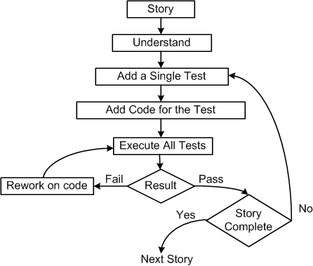
7. Unit testing in extreme programming
Figure 3.3: Test-first process in XP

Slide 33
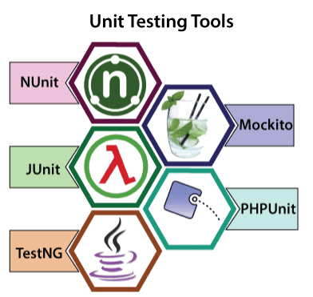
8. Tools for Unit Testing
https://www.javatpoint.com/unit-testing-tools

Slide 34
8. Tools for Unit Testing
Nunit (C#):
  Features of NUnit
    It powerfully supports the data-driven tests.
    In this, we can execute the tests parallelly.
    It allows assertions as a static method of the asset class.
    It uses a console runner to load and execute tests.
    NUnit supports various platforms such as Silverlight, Xamarin mobile, .NET core, and compact framework.
https://www.javatpoint.com/unit-testing-tools

Slide 35
8. Tools for Unit Testing
Junit (Java):
  Feature of JUnit
    It offers the assertions for testing expected results.
    In this tool, we can quickly develop a code that enhances the quality of the code.
    This tool can be structured in the test suites, which have the test cases.
    To run the test, it gives the test runners.
    It will take less time to run the test cases.
https://www.javatpoint.com/unit-testing-tools

Slide 36
8. Tools for Unit Testing
TestNG (Java and .Net programming languages)
  Features of TestNG
    TestNG support various instance of the same test cases, parameterized, annotation, data-driven, functional, integration, and unit testing.
    In the case of development, TestNG will be used to develop a unit test case, and each unit test case will test the business logic of the source code.
    It will provide a flexible test configuration.
    It will have the Dependent methods for application server testing
    With the help of TestNG, we have full control over the test cases and the execution of the test cases.
    It is supported by multiple plug-in and tools such as IDEA, Eclipse, and Maven, and so on.
https://www.javatpoint.com/unit-testing-tools

Slide 37
8. Tools for Unit Testing
Mockito
  The primary objective of using this tool is to simplify the development of a test by mocking external dependencies and use them in the test code.
  Feature of Mockito
    It will be used to support exceptions.
    With the help of the annotation feature, we can produce the mocks.
    We do not need to write the mocks object on our own.
    It will support return values.
    It provides multiple methods like verify(), mock(), when(), etc., which are helpful to test Java applications.
https://www.javatpoint.com/unit-testing-tools

Slide 38
8. Tools for Unit Testing
PHPUnit
  Features of PHPUnit
    PHPUnit will provide the logging, code coverage analysis.
    Its development is hosted on GitHub.
    PHPUnit uses assertionsto validate the performance of the specific component.
    With the help of this tool, developers can identify the issues in their newly developed code.
https://www.javatpoint.com/unit-testing-tools

Slide 39
THE END

